Slide 1
COSH 2026 – SPEAKER INFORMATION
This Speaker’s Guide has been prepared to provide important information and guidance regarding speaker’s presentation preparation and arrangements:
i) ATTIRE
Speakers are required to dress neatly and wear formal coats or blazers during the presentation.
ii) SLIDE PRESENTATION
Minimum font size: 20
PowerPoint version: 2010 or later
Final presentation slides to be submitted to NIOSH Liaison Officers
Presentation content should align with COSH 2026 theme: “Wellbeing at Work”
Avoid sensitive issues (e.g., race, religion, politics)
Excessive self-promotion should be avoided
Presentation language: English
iii) SESSION FORMAT
Each presentation is allocated for 15-20 minutes (it is highly advisable not to exceed 15 slides).
Q&A session will follow after all presentations.
iv) ATTENDANCE IN THE PRESENTATION HALL
Presenters must be ready at the presentation hall 30 minutes before the scheduled session.
Your cooperation to comply with these guidelines is greatly appreciated.
Thank you.

Slide 2



SHAPING THE SAFETY CULTURE THROUGH HSE PARTICIPATION
NAZIADIN ABD GHANI
ARKEMA THIOCHEMICALS SDN BHD
15TH SEP 2026
#wellbeingatwork

Slide 3

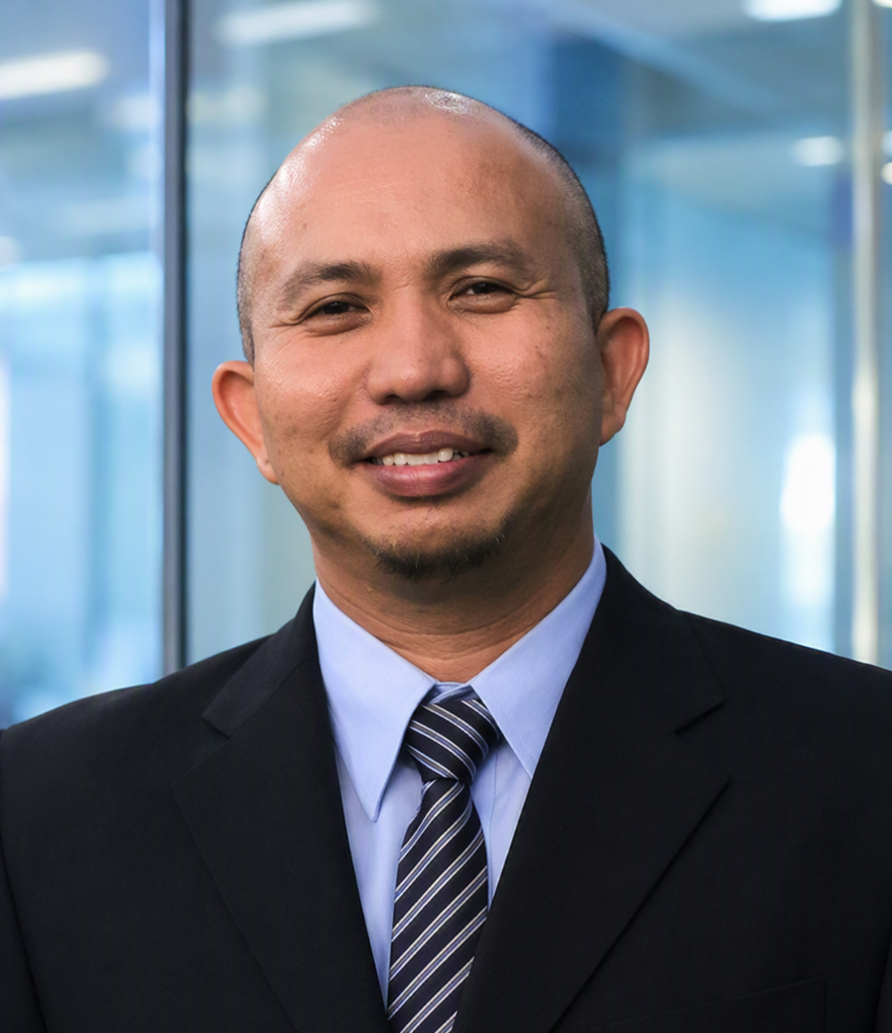

NAZIADIN ABD GHANI
Speaker Profile
HEAD OF DEPARTMENT - HSE
ARKEMA THIOCHEMICALS SDN BHD
Naziadin Abd Ghani is the Head of Department – HSE at Arkema Thiochemicals Sdn Bhd, with over 25 years of experience in Health, Safety, Security, Environment, and Quality (HSSEQ). He holds a Mechanical Engineering degree and has extensive experience in both upstream and downstream oil and gas operations.
In his current role, he leads HSE culture programs and contributes to Arkema’s achievement of 12 years without a Lost Time Injury (LTI). He is responsible for driving strategy, improving safety performance, and ensuring compliance with HSE standards.
Previously, he held a senior HSSEQ leadership role, contributing to over 20 years without LTI, recognized in the Malaysia Book of Records. He is also an award-winning HSE leader with multiple industry recognitions
.A recognized speaker, he shares knowledge and promotes innovation, remaining committed to building safer and more sustainable workplaces.
[Within 100-150 words]
#wellbeingatwork

Slide 4
[Within 150-200 words only]
Summary : A strong safety culture doesn’t happen by chance—it is built through the active participation of every employee. HSE programs are essential not only to prevent incidents but to protect lives, safeguard the environment, and sustain business performance. This presentation highlights why employee involvement is the key to making HSE programs truly effective. When individuals take part in activities such as hazard reporting, safety observations, and awareness campaigns, they become the first line of defense against risks. To drive engagement, an HSE points system is introduced as a practical way to track participation and reward positive behavior. By linking involvement to recognition and incentives, employees are motivated to stay alert, take ownership, and lead by example. Ultimately, safety is a shared responsibility. When everyone participates, HSE becomes a culture—not just a requirement—creating a safer, more accountable, and high-performing workplace.
Keywords: Safety Culture, accountability, awareness, HSE performance
Topic : “Shaping the safety culture through HSE Participation”
#wellbeingatwork

Slide 5
THANK YOU
<NAME>
<EMAIL>
<ROLE&ORGANISATION>
#wellbeingatwork

